Slide 1

LONGS AND SHORTS, STOCK SELECTION AND WEIGHTING
Using Data Analytics and Statistical Techniques
MATH 377, zuchukwu Egonu

Slide 2
Overview
Problem &
Opportunity
🧭
🧩
This project implements a long-short equity strategy using momentum-based signals and portfolio optimization techniques.
Monthly, stocks from the S&P 500 are ranked using standardized momentum scores, with the top 10 forming a long basket and the bottom 10 a short basket.
Monte Carlo simulations are used to optimize portfolio weights—either maximizing the Sharpe ratio or minimizing volatility.
The strategy is backtested over a five-year period to evaluate performance against the SPY ETF.
The Problem:
Retail investors and portfolio managers often rely on static investment strategies or subjective decision-making, which can lead to suboptimal performance. Without systematic frameworks, it's difficult to adapt to shifting market conditions. This creates challenges in identifying outperforming stocks and managing portfolio risk effectively.
The Opportunity:
Using momentum factors and portfolio optimization, we can build a dynamic, data-driven strategy that adapts monthly to market conditions—enhancing returns and managing risk better than static approaches.

Slide 3

Vision
🔍
🛠
🤖
📈
Understand the Data
Collect historical asset prices, economic factors, and market indicators.
Gather real-time sentiment data from Twitter, Reddit, and crypto news.
Engineer Smart Features
Generate technical indicators (e.g., RSI, MACD).
Convert text data into sentiment scores using Natural Language Processing.
Build Predictive Models
Train advanced models to capture time patterns.
Evaluate performance using metrics like MAE and RMSE.
Deliver Insights
Model provides long and short positions as well as weights that best determine future price action.
🌍 Goal: Create a practical, data-driven tool to guide investors with better timing and lower risk.

Slide 4
Potential Impact
💸
🧠
📉
🌍
Financial Impact
Improved selection accuracy could help investors reduce losses during downswings and maximize gains during upswings.
Better
Decision-Making
Offers a data-driven alternative to emotional or speculative trading.
Enables users to make more informed long or short decisions with greater confidence.
Risk Reduction
Anticipating volatility can help users hedge, rebalance, or exit risky positions early.
This reduces exposure to abrupt market crashes driven by news or social sentiment.
Alternative Applications
The same framework can be adapted to forecast assets such as cryptocurrencies, non-fungibles, or volatile assets.

Slide 5




Data Sources

Slide 6
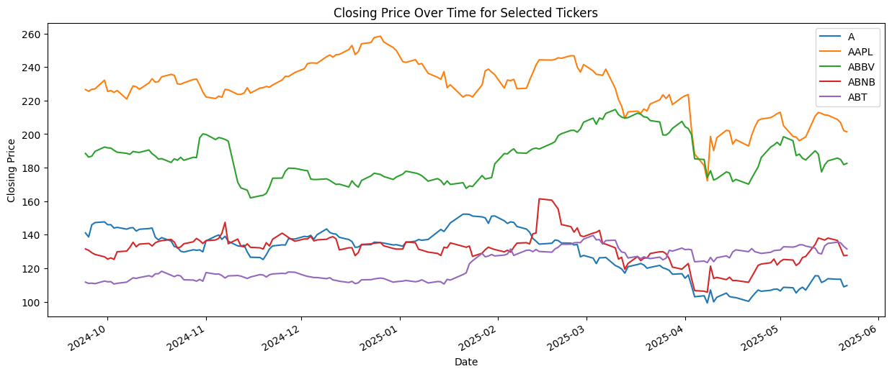
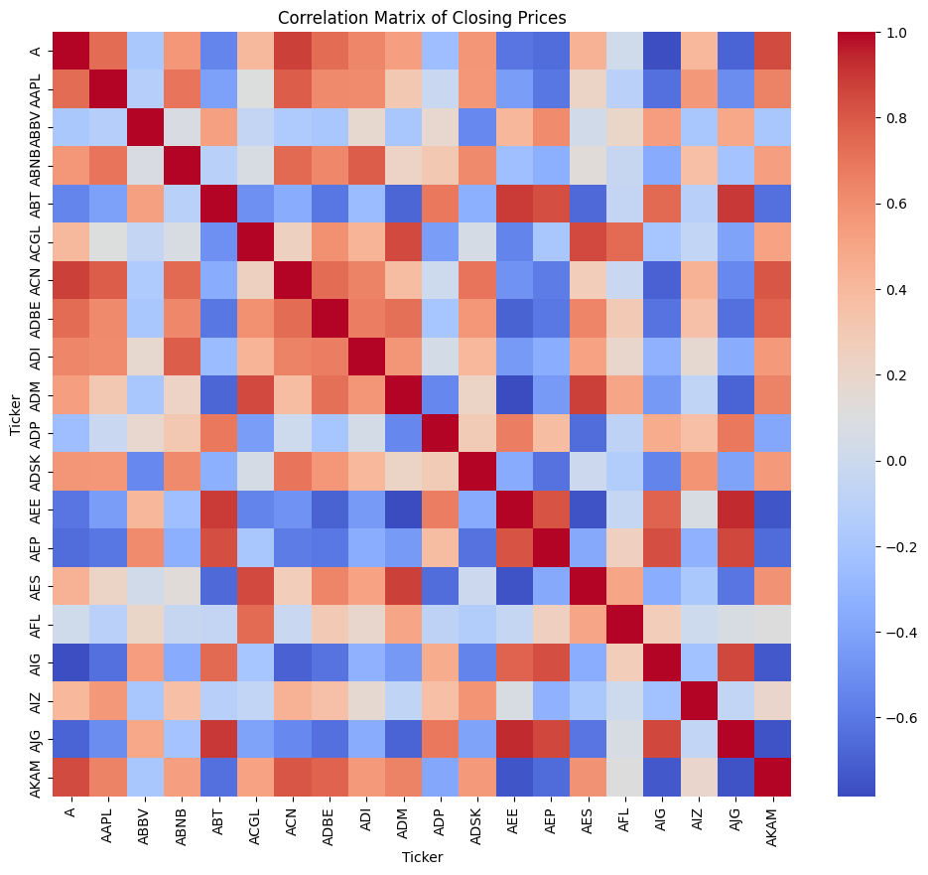
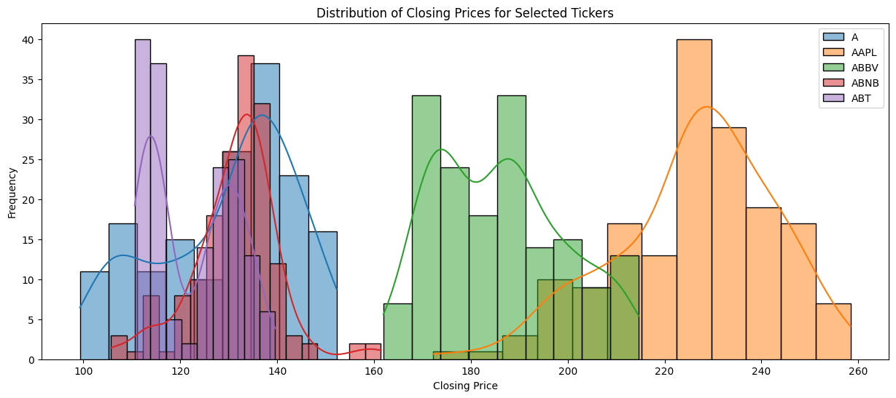
Y-Finance EPA

Slide 7

Next Step
Text Data Sources
Real Time Sentiment Scores
" Stock is falling”
Score: +.82
Natural Language Processing
" NVDA to the Moon🚀"
Score: +0.78
"This morning TSLA has declined by 3.5%”
Score: -0.02

